Slide 1
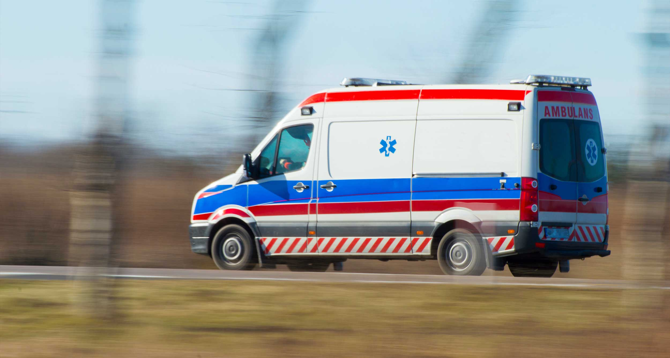
Predicting Response Time in EMS arrival
Al-Jalil Gault | David Park | Public Policy Analytics
Illustration: WheelchairTravel.org
Notes:
The purpose of this project is to help users understand how long it will take for an ambulance to arrive. When someone needs medical services, knowing the fastest ways they can receive medical attention is important. We want to create a tool that supports the well-being and safety of all people, in the most efficient way possible.

Slide 2
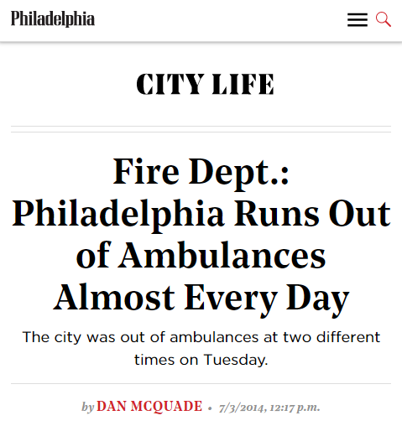
Delays in Emergency Medical Services are an Imminent Threat
A Study of North Los Angeles County, found that 14.8% of EMS calls were delayed.
The average time of the delay was 35 mins.
Notes:
Delays in EMS are an imminent threat. A study in north LA found that roughly 14.8% of EMS calls were delayed. The average wait time of a delay was 35 mins. Even in here Philadelphia, this article to the right shows that we run out of ambulances everyday due to overcapacity. These delays are a problem.

Slide 3
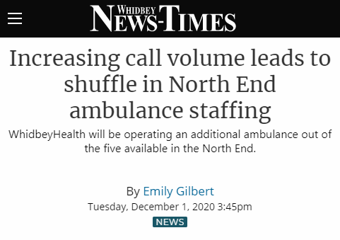
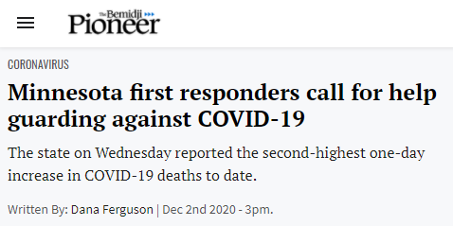
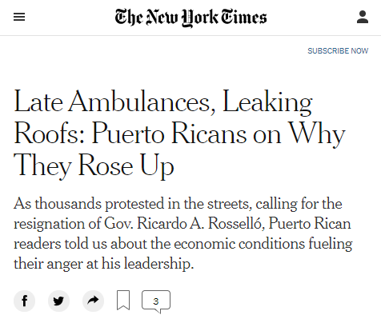
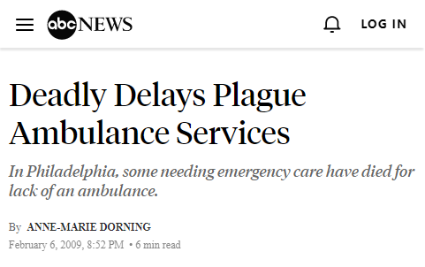
We Must Plan for Adjustments
Notes:
We must plan for adjustments. Delays are a problem for hospitals, workers, and citizens in need. Even today, delays in EMS services are catalyzing civic unrest in Puerto Rico, causing first-responders to call for additional help in Minnesota, and putting lives at risk.

Slide 4
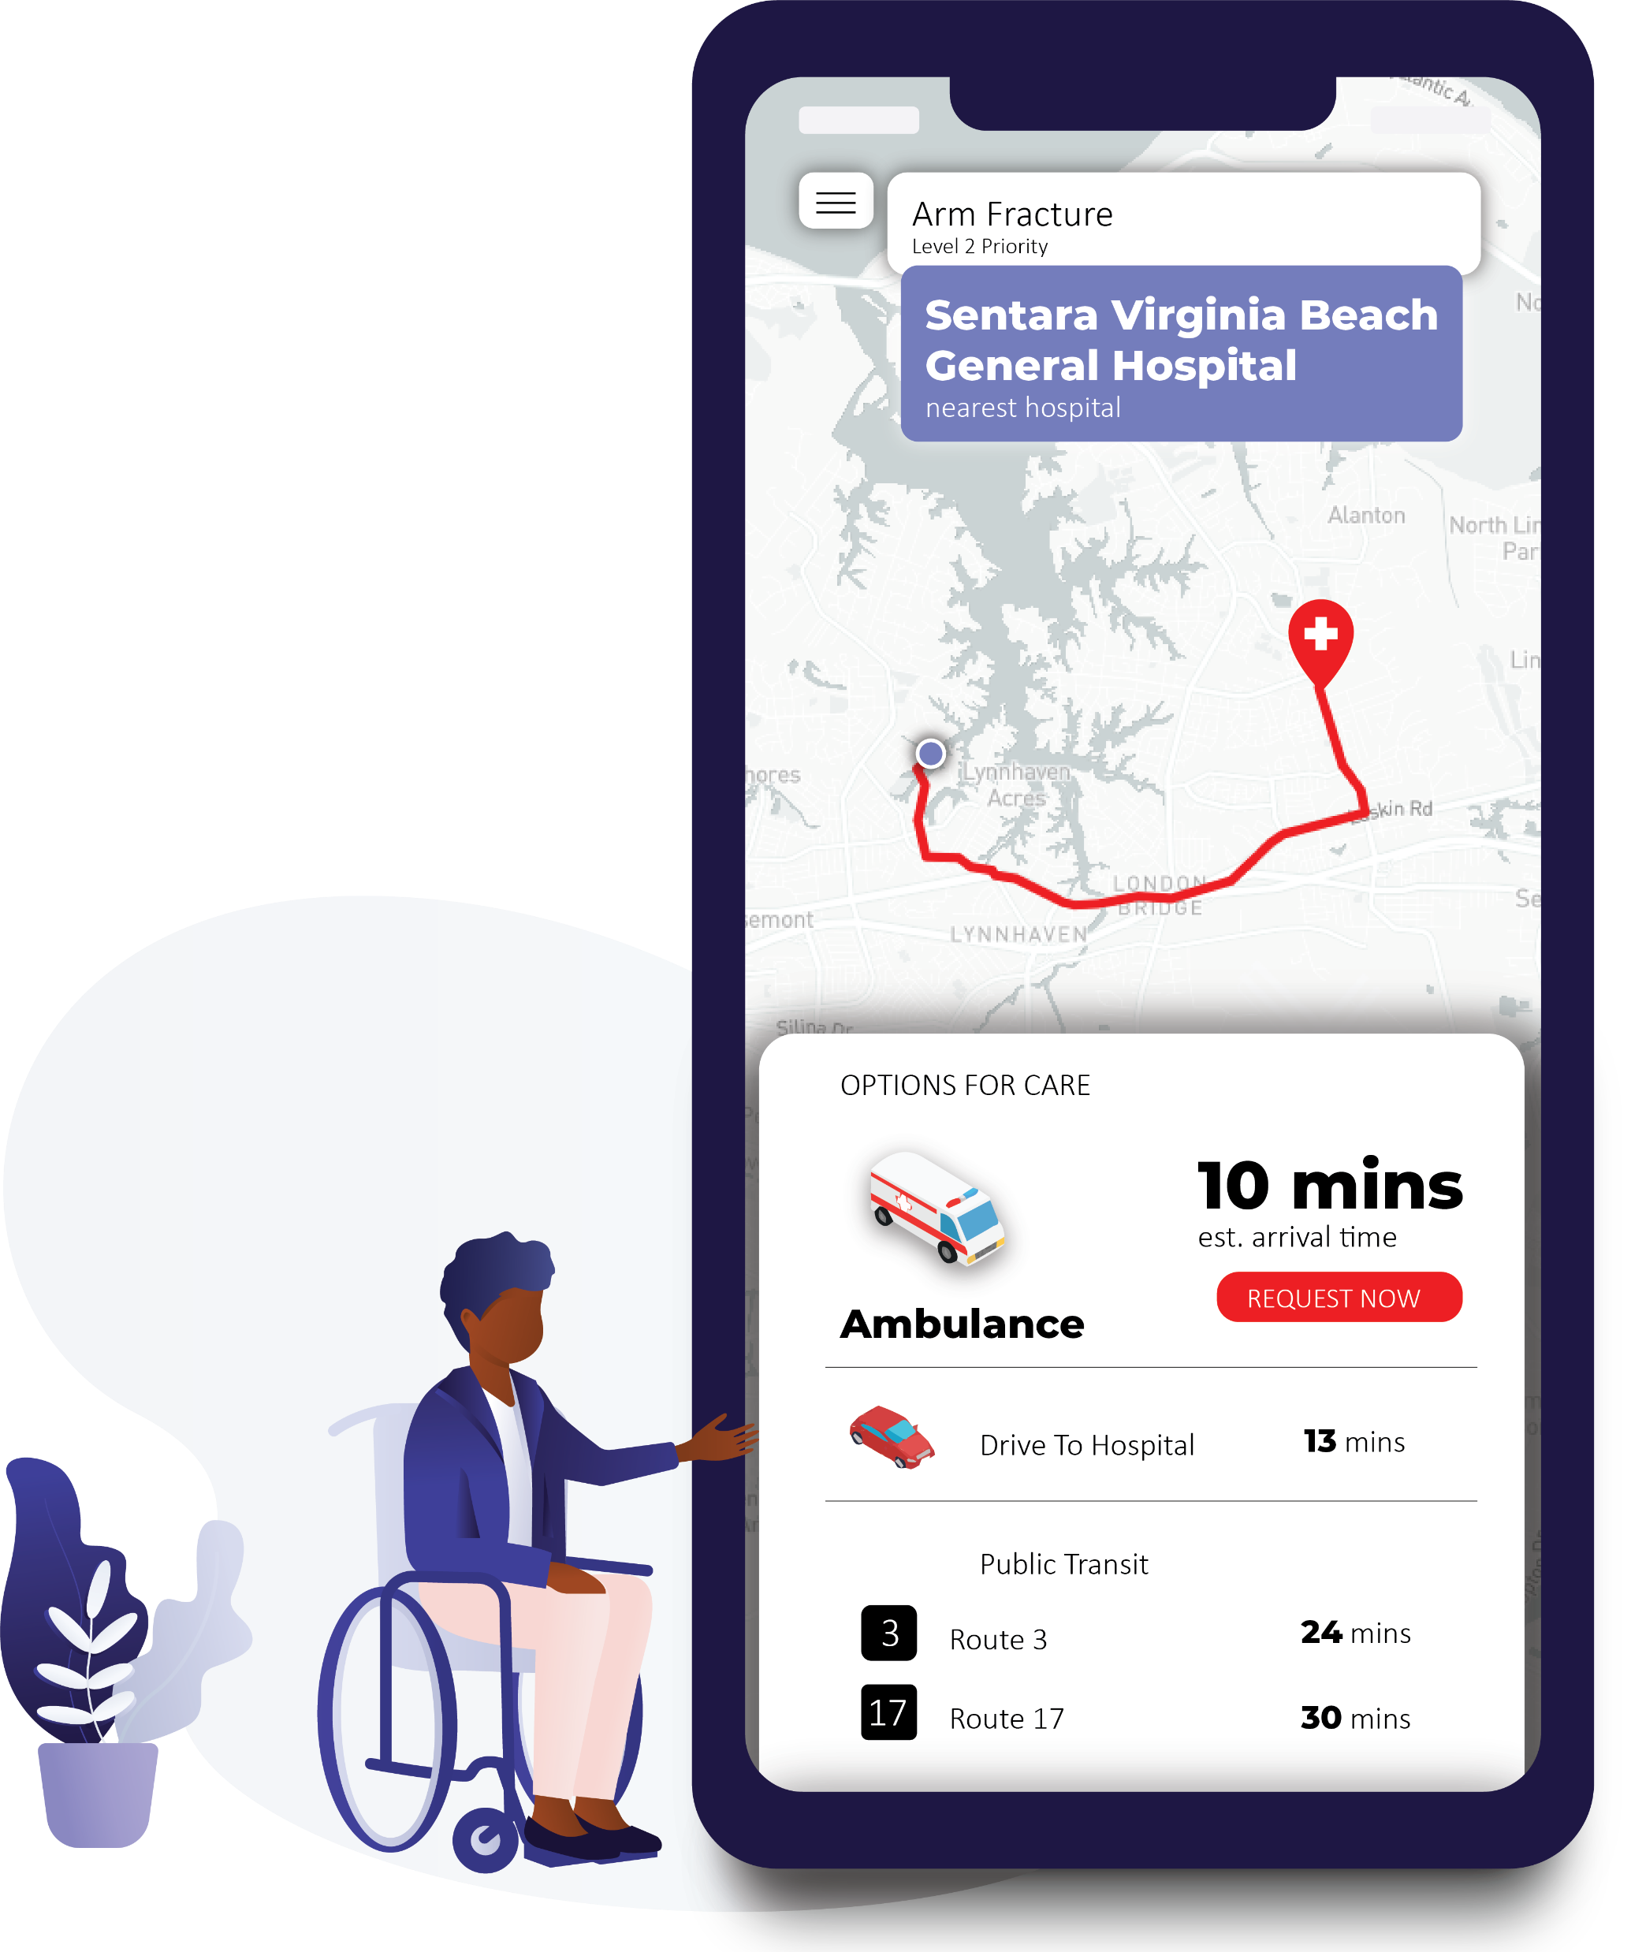
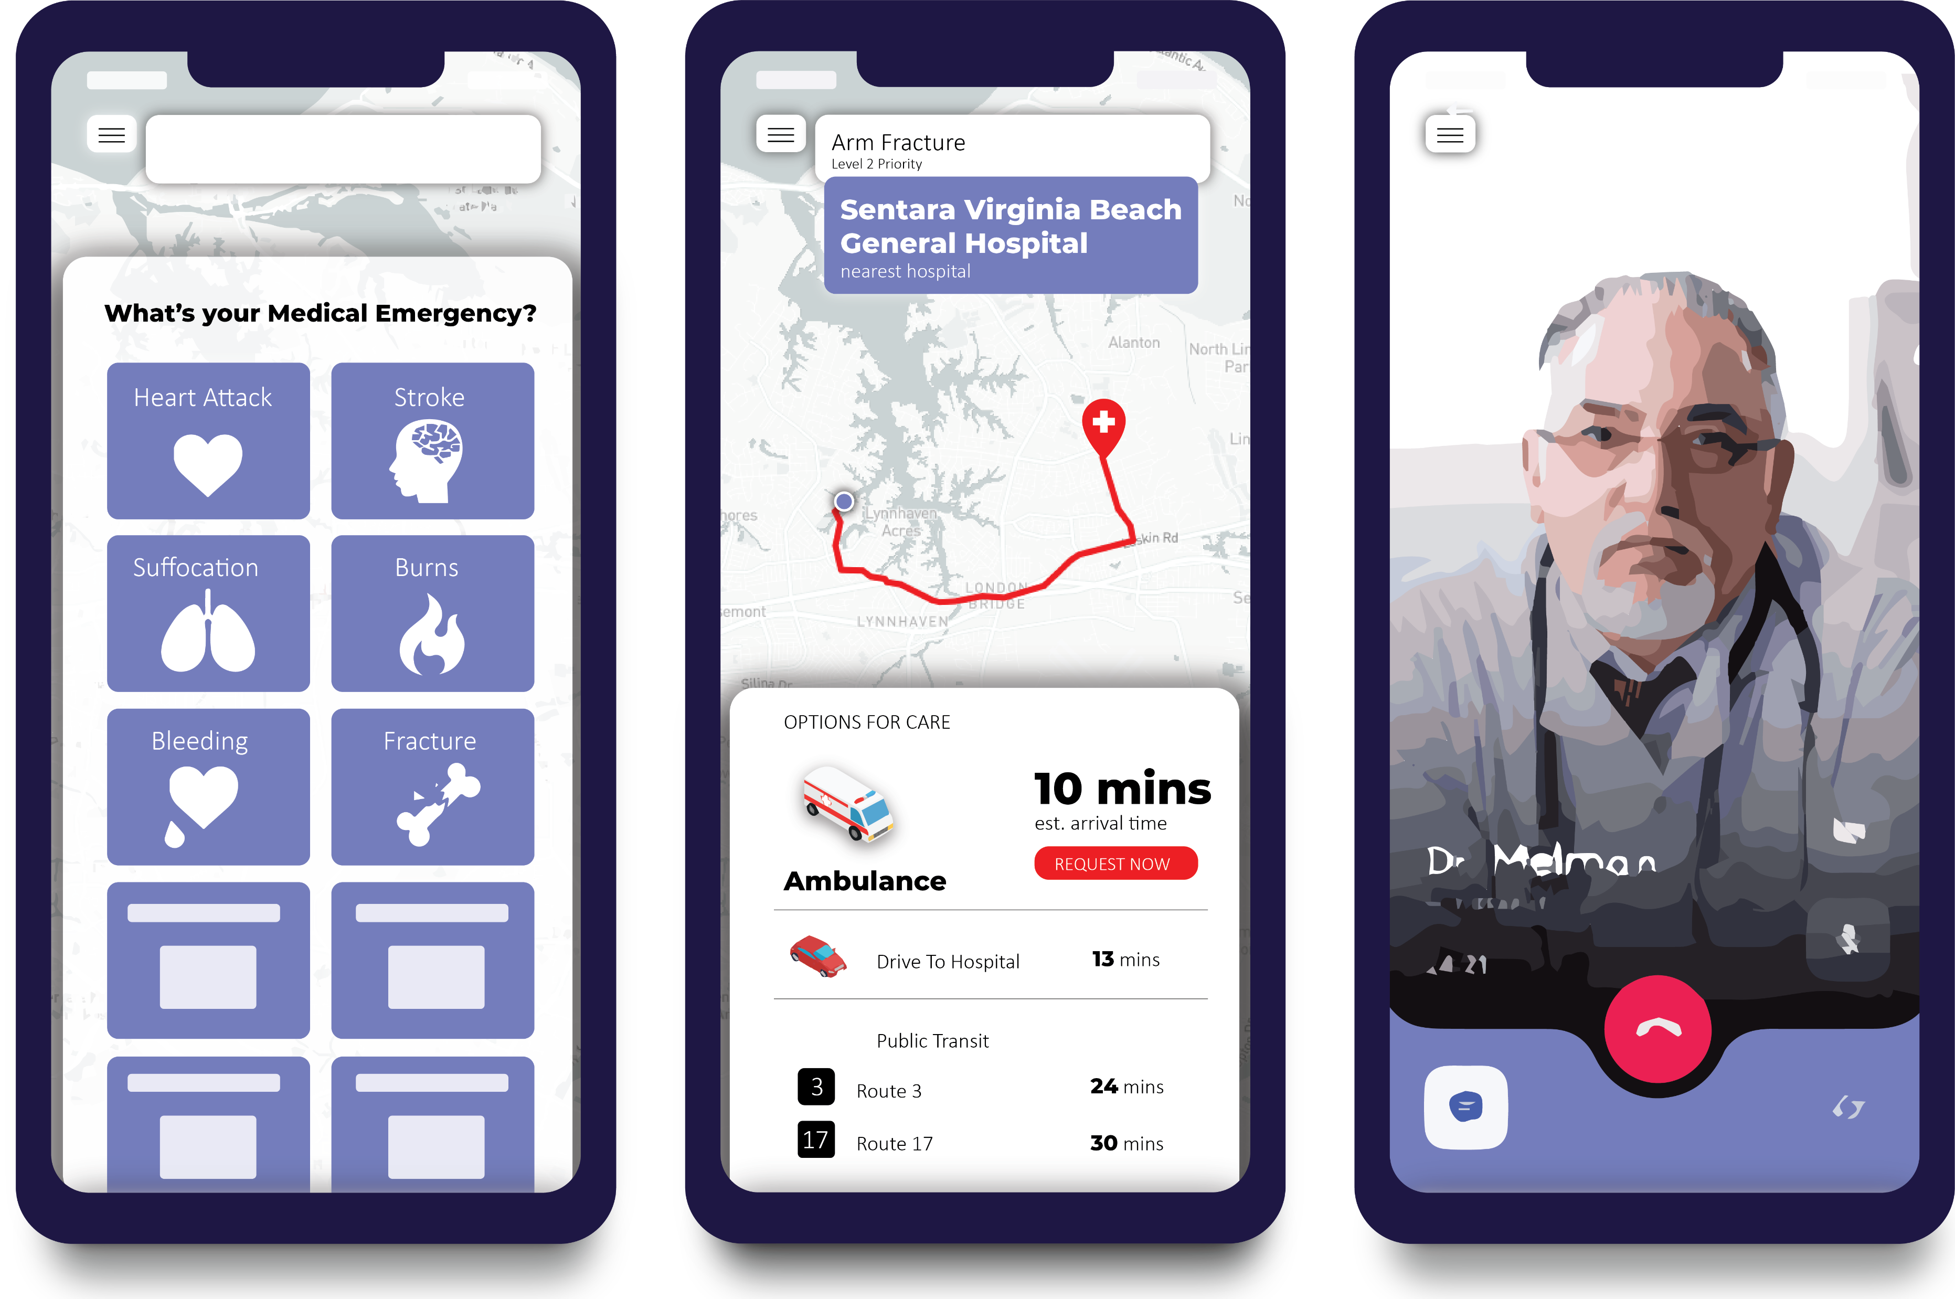
Knowledge for those in need:
MyEMS
Select your Emergency
Receive timing for care
Get help while waiting
Notes:
We would like to present MyEMS, an app to help users understand how long it would take if they request an ambulance, and then make an informed decision about how to get care based on all other options: including car travel and public transportation. The app will also allow them to receive telemedicine while en route.

Slide 5
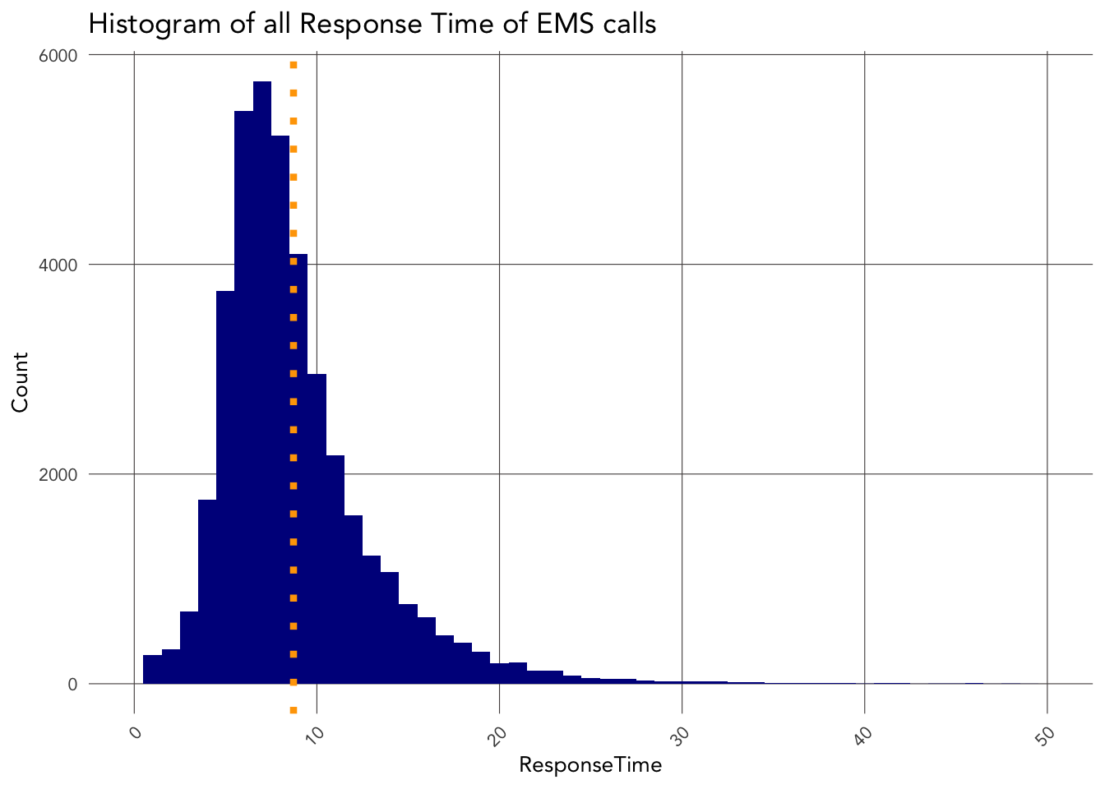
How do we know?
8 min average response time
± 2.5 mins
Notes:
And so the key question is: How do we know how long it will take for an ambulance to arrive on scene of an emergency? We’ve obtained a history of EMS calls from Virginia Beach. The graph on the right shows the distribution of these response times, with an 8 min average. Based on 2 years of data, we’re able to use delay patters from the past and predict delays into the future with only a 2.5 min error.

Slide 6
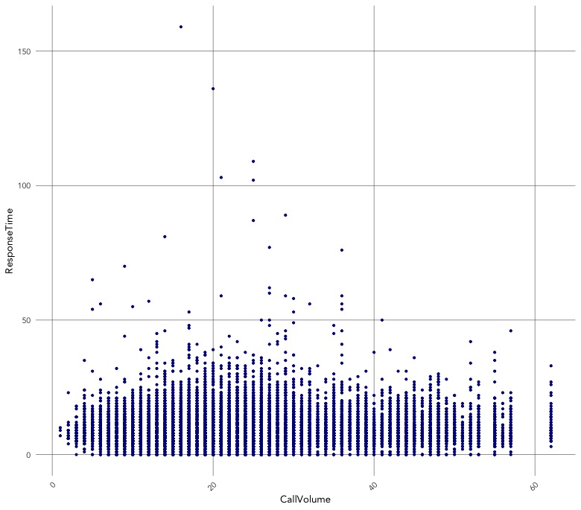
Patterns from
Historical Calls
Volume of Calls
Call Volume is not the sole predictor of EMS Delays
Notes:
If we examine the relationship between call volume and EMS response time, we can see that call volume is not the sole predictor of EMS delays. So, what are some other factors that contribute to delays? I’ll spend the rest of this presentation exploring this question.

Slide 7
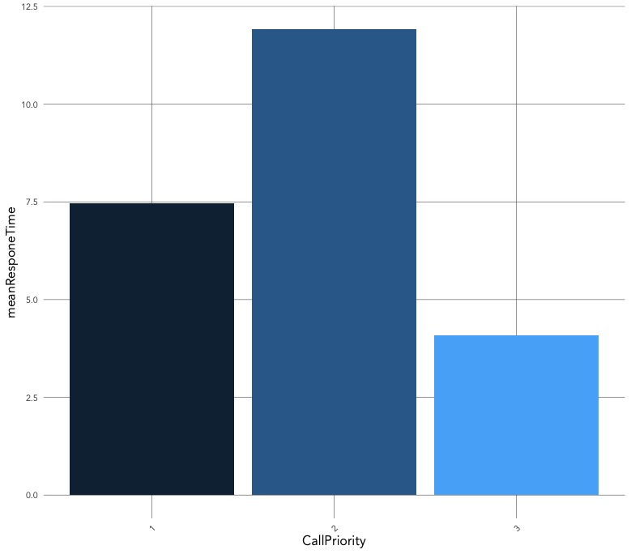
Patterns from
Historical Calls
Incident Priority
Priority 2 incidents have the longest response time
Priority 1 – life threatening, salvageable
Head injuries
Severe burns
Heart attack
Breathing impaired
Internal injuries
Priority 2 – Moderate/Serious injury, not life threatening
Fractures
Post-stroke, but stable
Altered mental status
Priority 3 – “Walking Wounded”,
Notes:
The first feature of these calls that help us make predictions is the call’s priority. Based on the chart to the right, we can see that calls with priority 2 incident classifications tend to have the highest response times. These incidents include moderate-serious injuries that are not life threatening.

Slide 8
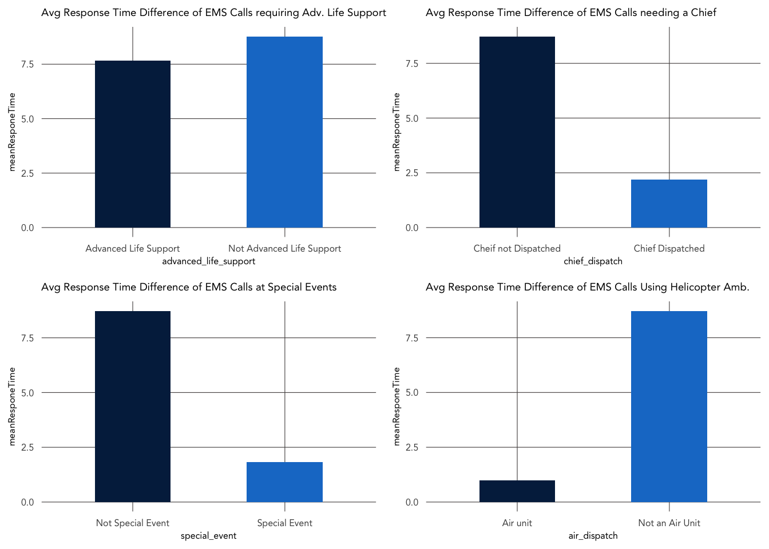
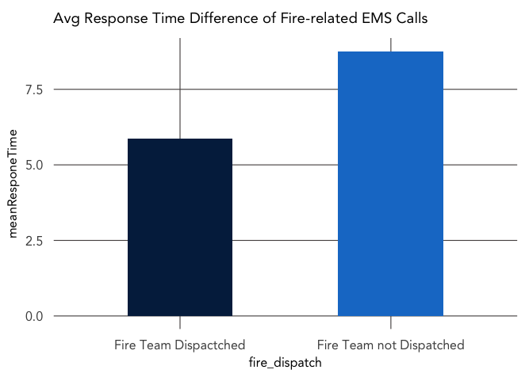
Patterns from
Historical Calls
Emergency Characteristics
Emergencies requiring
Advanced Life Support
have shorter response times
Emergencies at Special Events have shorter response times
Fire-related Emergencies
have shorter response times
Notes:
The nature of the emergency also has a relationship to response time. We’ve found that emergencies at special events, requiring a bike or golf cart, emergencies requiring advanced life support such as a paramedic, and those that are fire-related, requiring a fire engine and ladder, all have shorter average response times.

Slide 9
Patterns from
Historical Calls
Time of Day, Day of Week
Delays are related to Time and space
EMS Stations
Notes:
Other features that have helped us make predictions are the time of the call and distance from EMS stations. The data has allowed us to analyze how delays are different throughout the week and across Virginia Beach. If we look at the bright-yellow dots, we’ll see that some of the longest wait times are in the farthest away between ems stations.

Slide 10
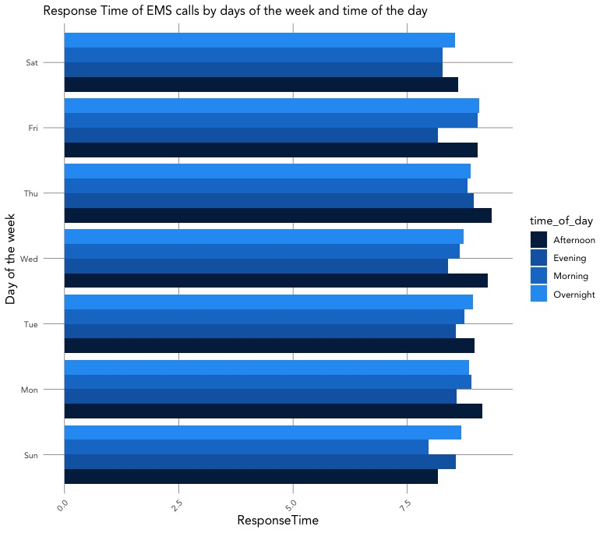
Patterns from
Historical Calls
Time of Day, Day of Week
Afternoon and Overnight Calls have the longest wait times
Notes:
If we focus only on the temporal relationship of delays on this chart, we can see that Afternoon and overnight calls tend to have the longest wait times, while evening and morning calls have the shortest wait times. Times consistently exceed 8 mins for all afternoon calls. Thursdays and Wednesdays tend to have the longest wait times.

Slide 11
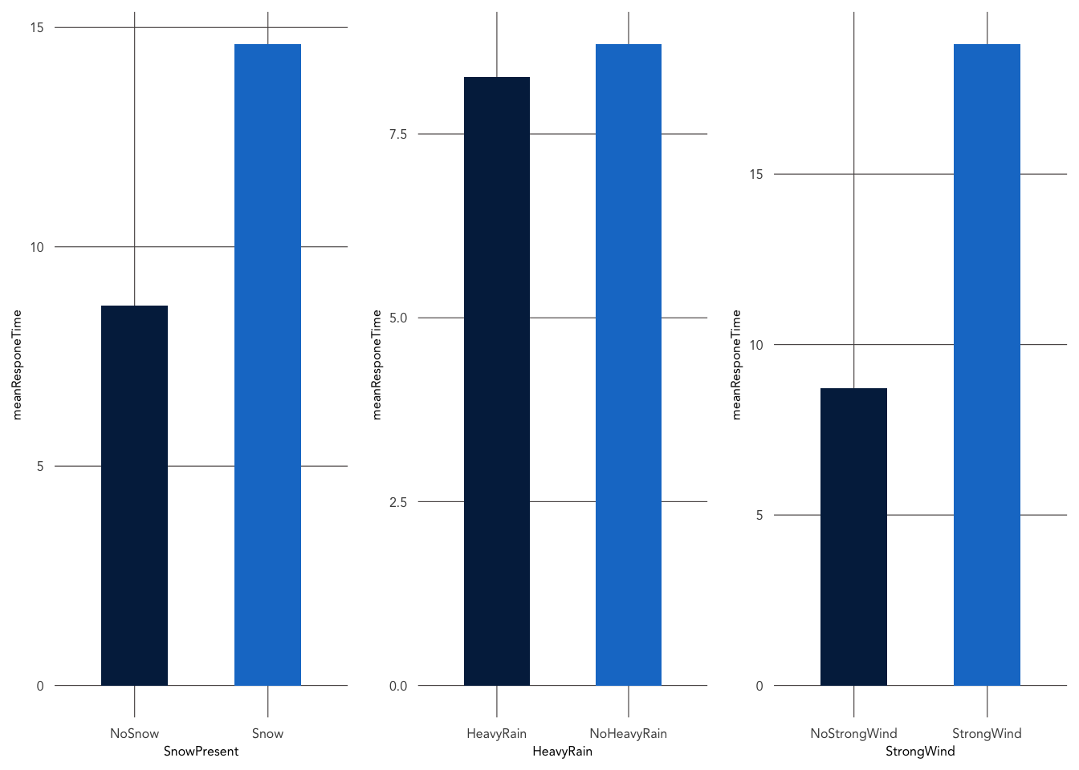
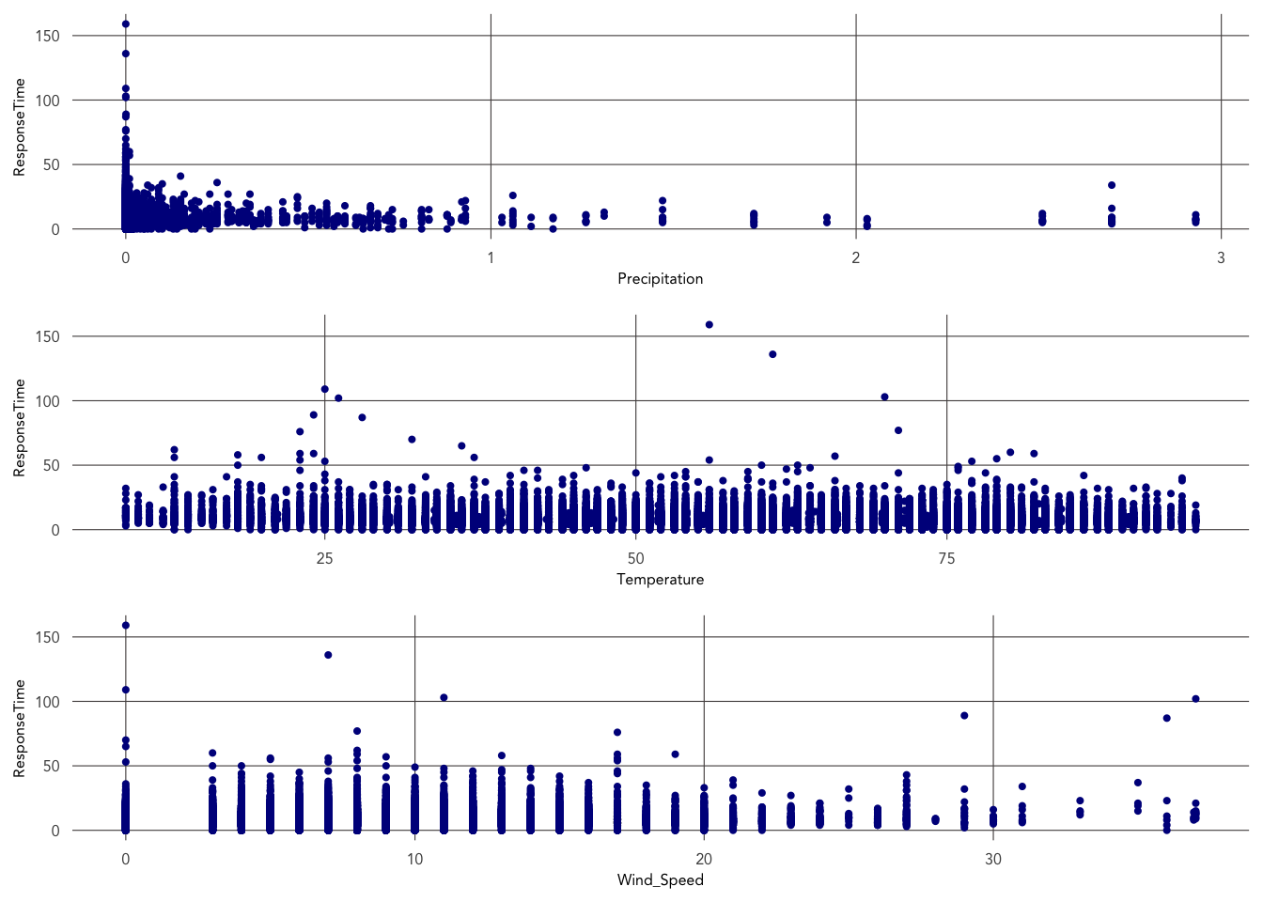
Patterns from
Historical Calls
Snowy days have longer wait times
Windy days have longer wait times
Weather
Precipitation
– no clear relationship
Temperature
– no clear relationship
Notes:
We’ve been examining how weather might impact EMS arrival. We’ve analyzed precipitation, temperature, and wind speed, but found that the clearest predictors for response time are days with heavy snow and heavy winds. Both of these environmental occurrences increase response time by more than 5 minutes.

Slide 12
Predicting Response Time in EMS arrival
Al-Jalil Gault | David Park | Public Policy Analytics
Notes:
Thank for your listening to this presentation. We know that an application which helps users understand how long it will take before Emergency Medical services arrive will help users make the safest, most timely decisions to support their well-being.

